Slide 1


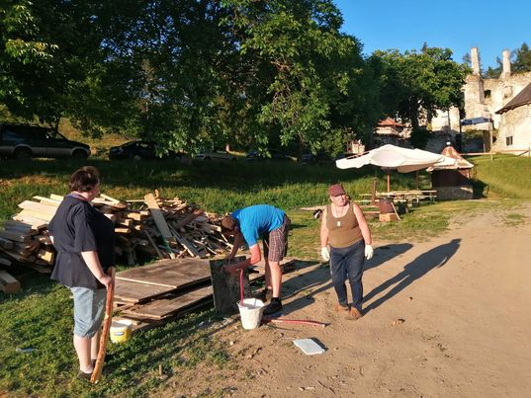
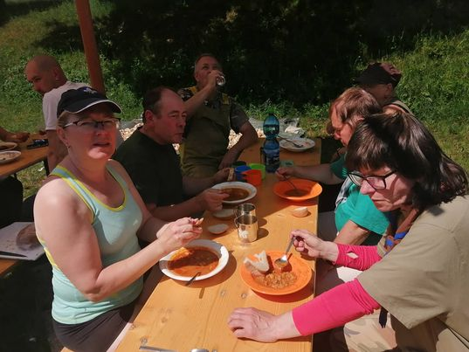
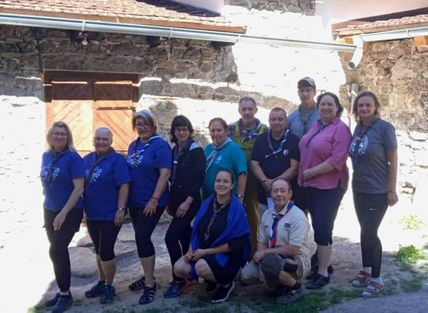
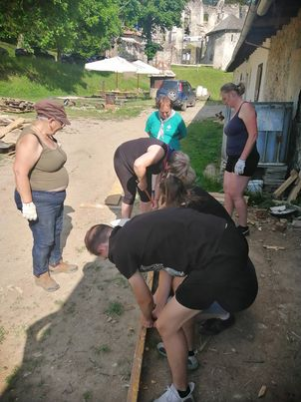
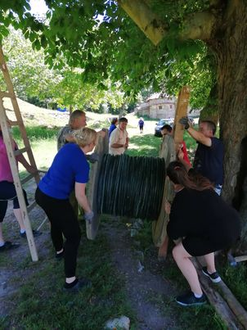
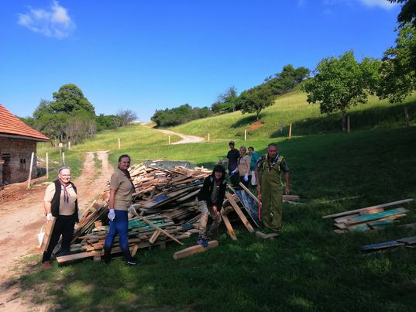
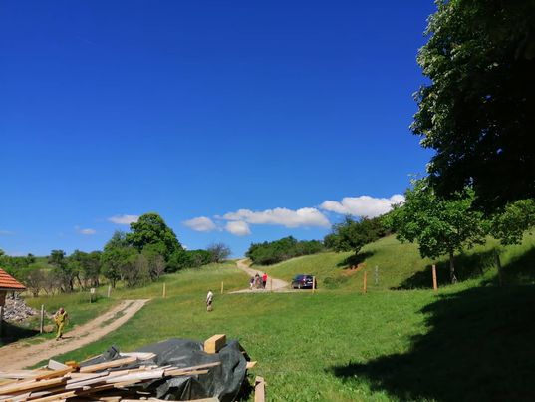
The third year of the decluttering of the Sklabiňa castle. Anlage 1
Sklabiňa
10th.-12th. Jun.2022

Slide 2

25th. Old scouts meeting of three countries
Terchová – Šípková
8.-11. septembra 2022

Slide 3
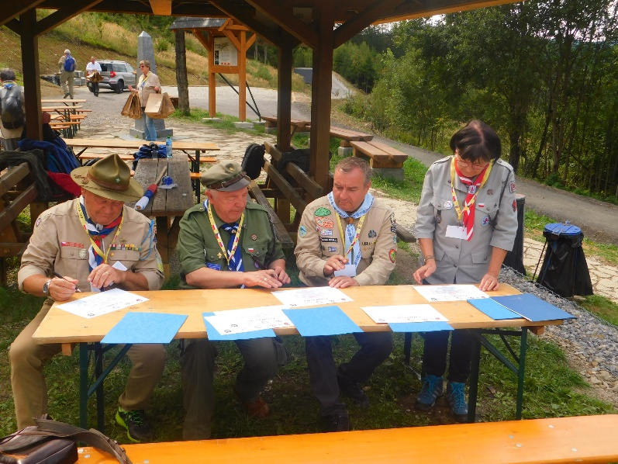
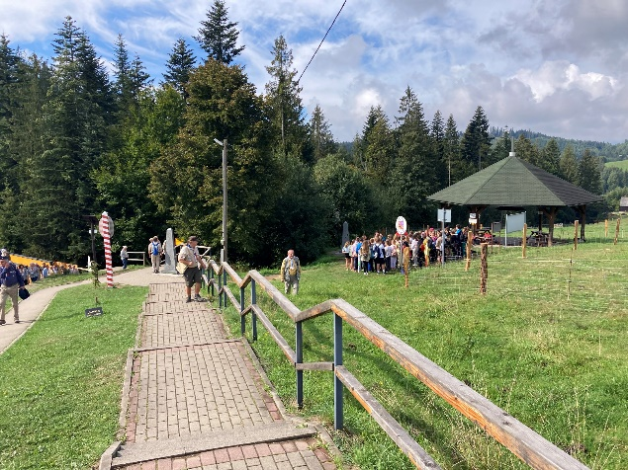
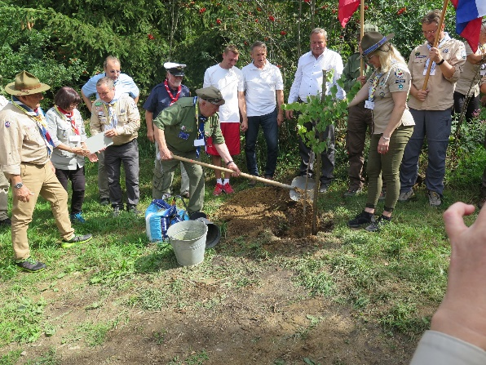
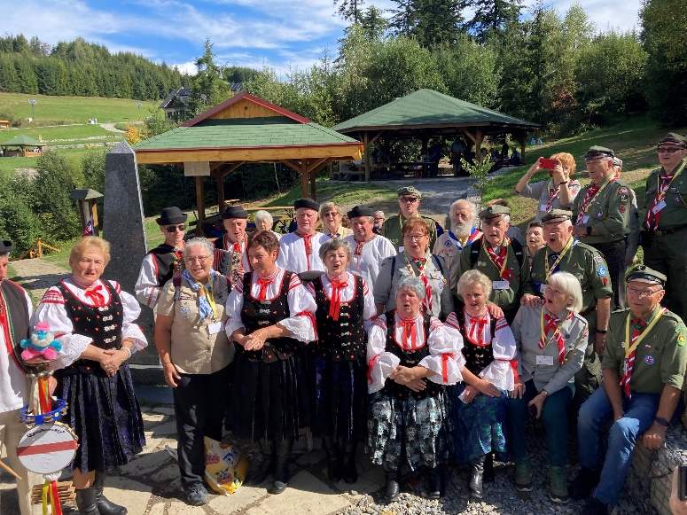
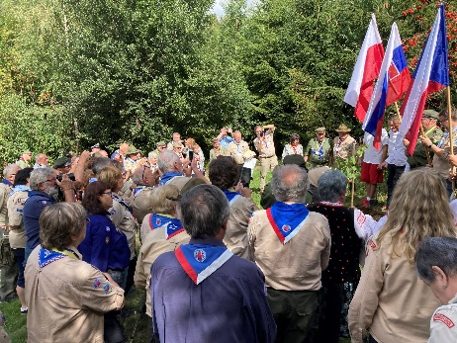
Meeting at the tri-border
Terchová – Šípková
8th - 11th September 2022

Slide 4
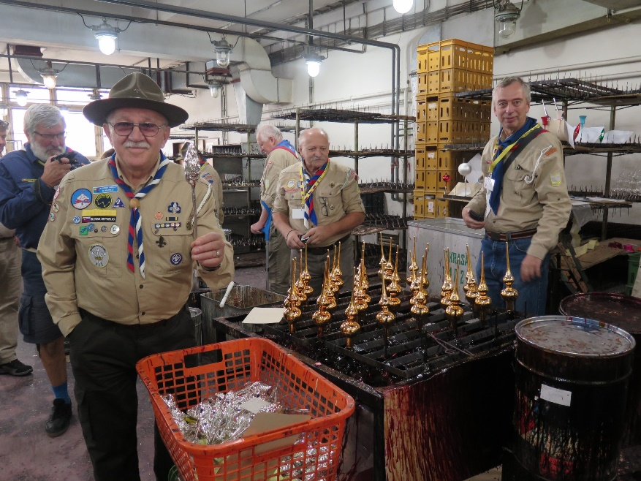
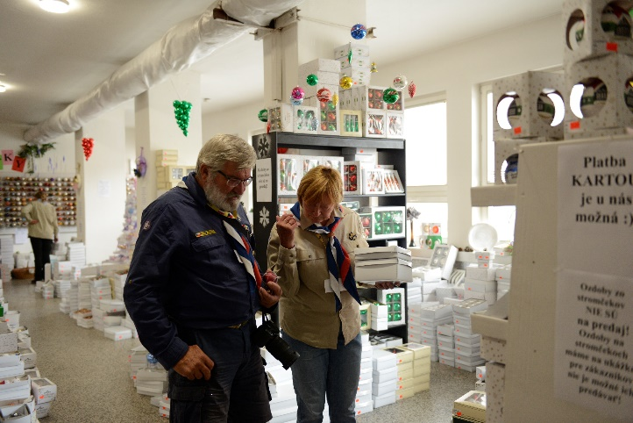
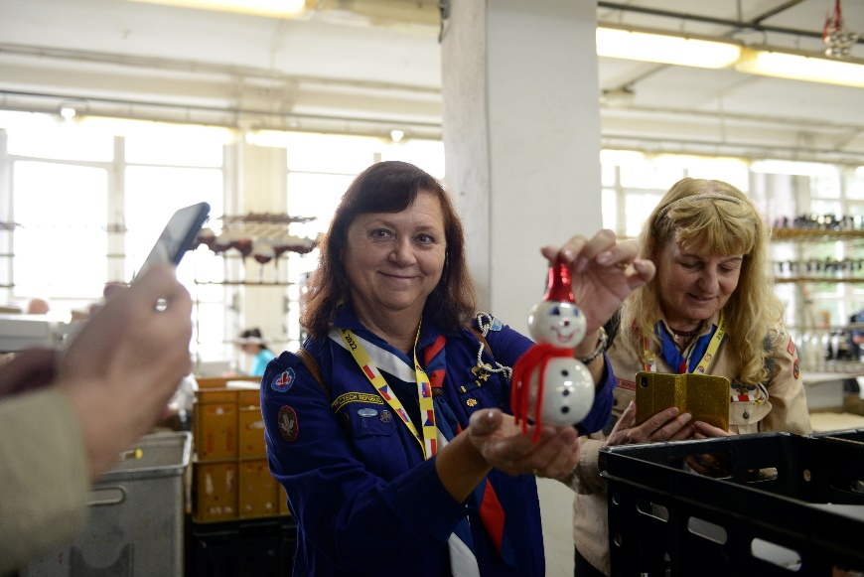
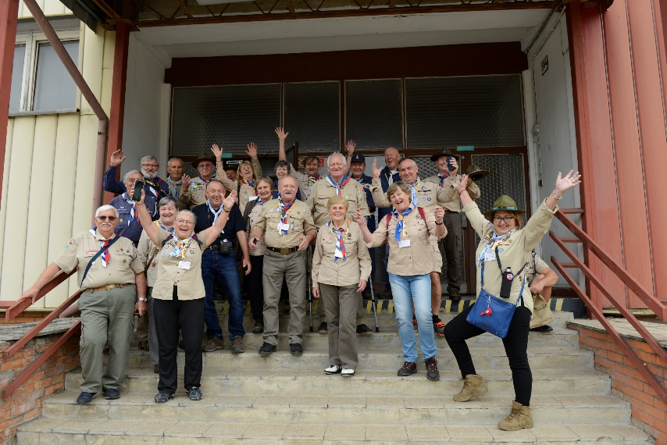
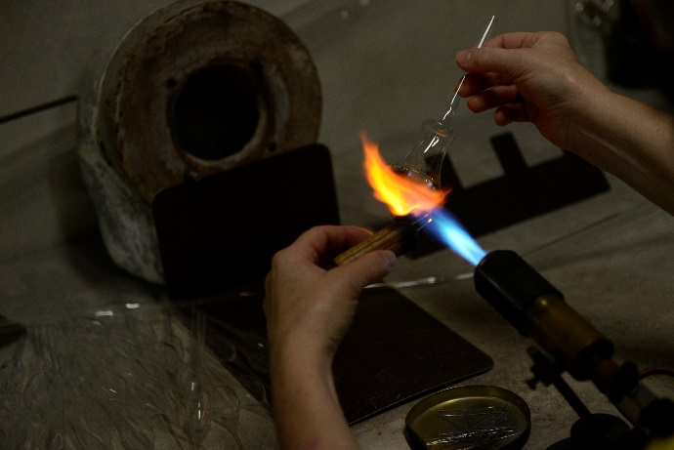
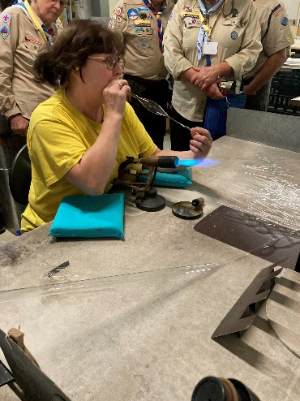
Visit to the factory of Christmas decorations
Terchová – Šípková
8th - 11th September 2022

Slide 5
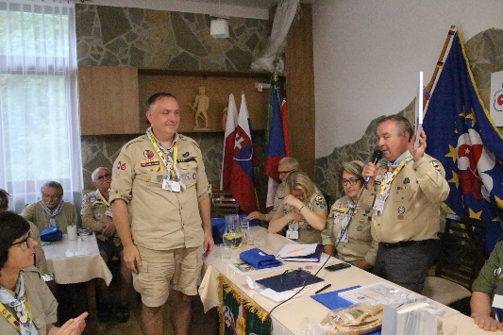
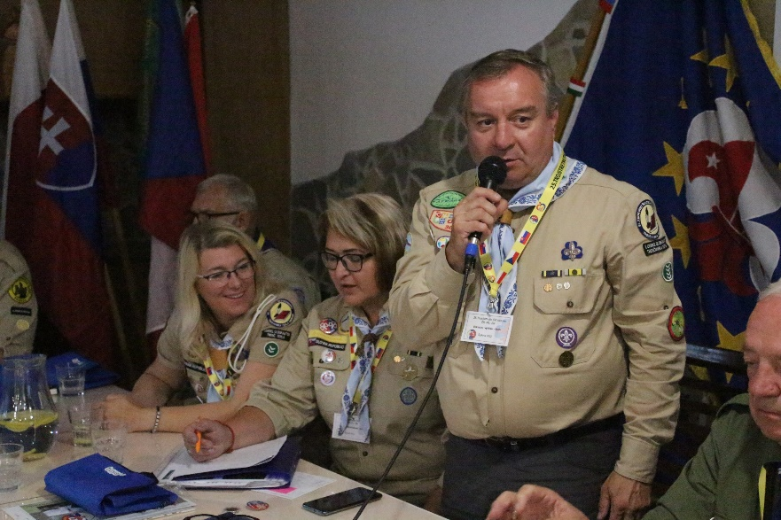
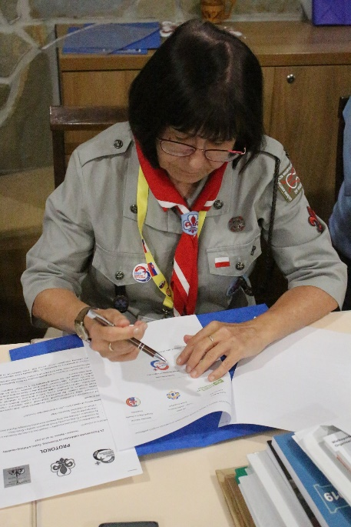
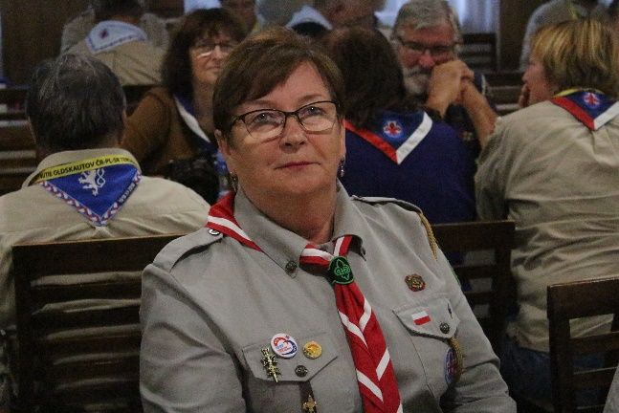
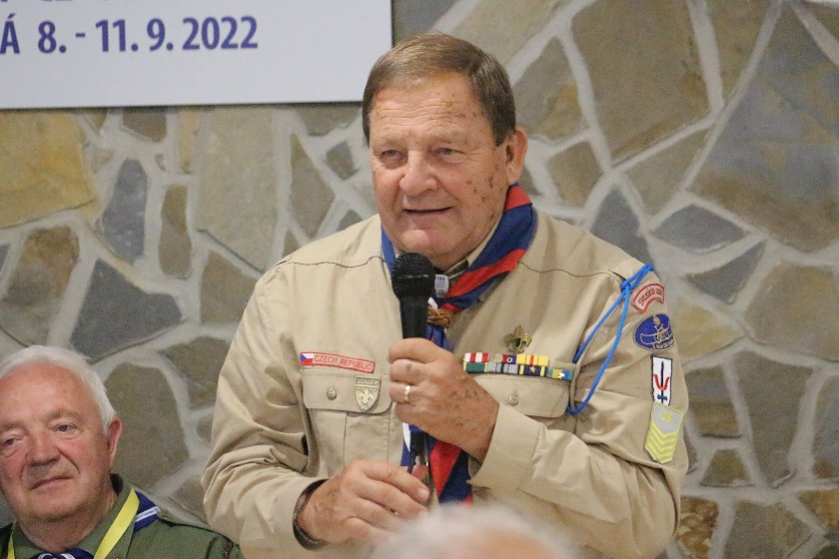
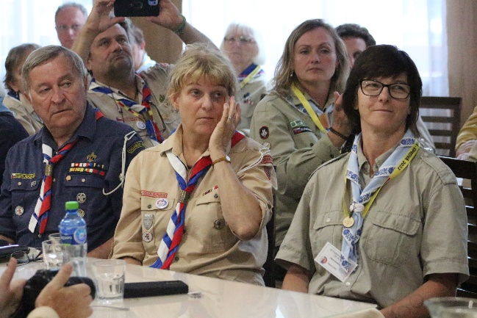
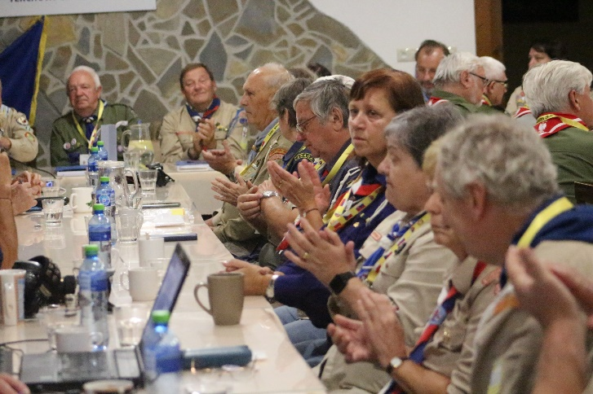
Commemoration of the 30th anniversary of the creation of the Subregion Central Europe
Conference – „without the past there is no future “
Terchová – Šípková
8th - 11th September 2022

Slide 6
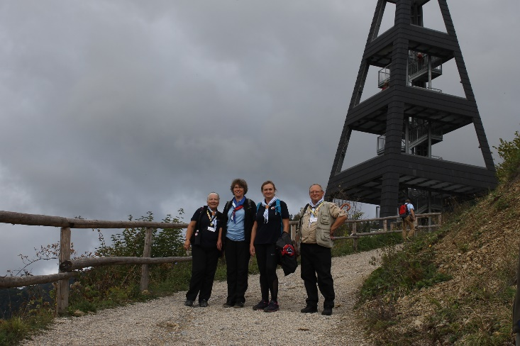
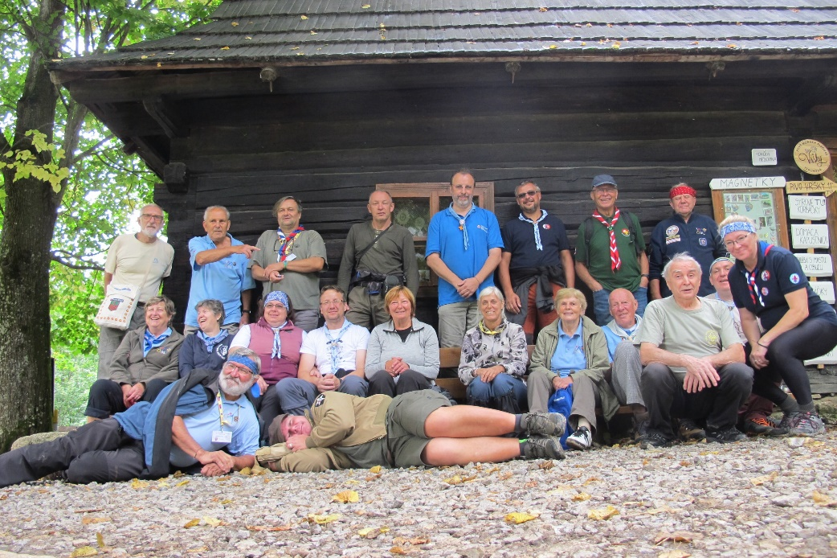
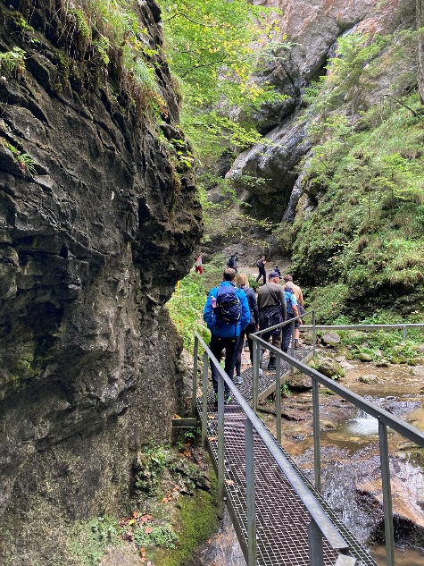
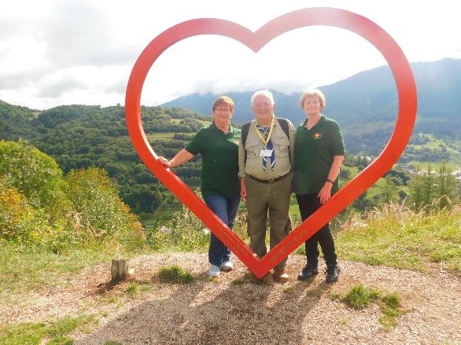
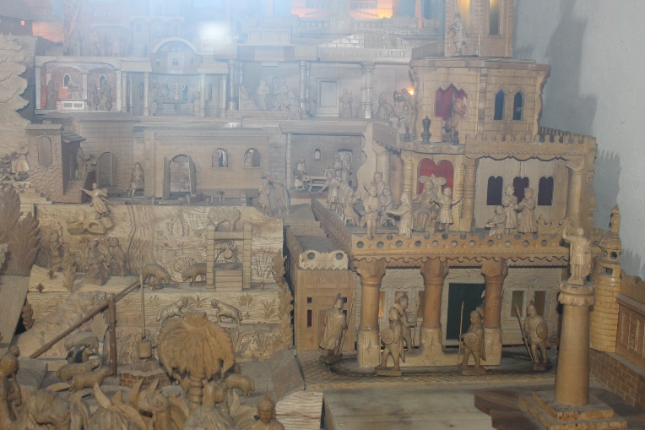
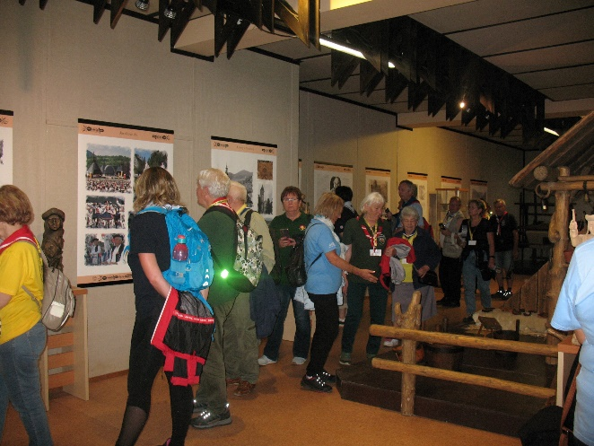
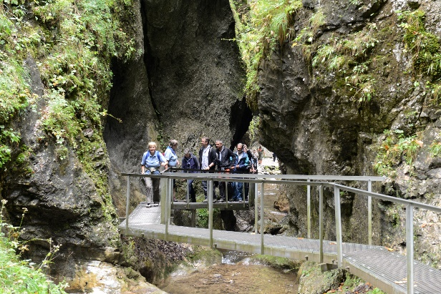
In Terchova
Terchová – Šípková
8th - 11th September 2022

Slide 7
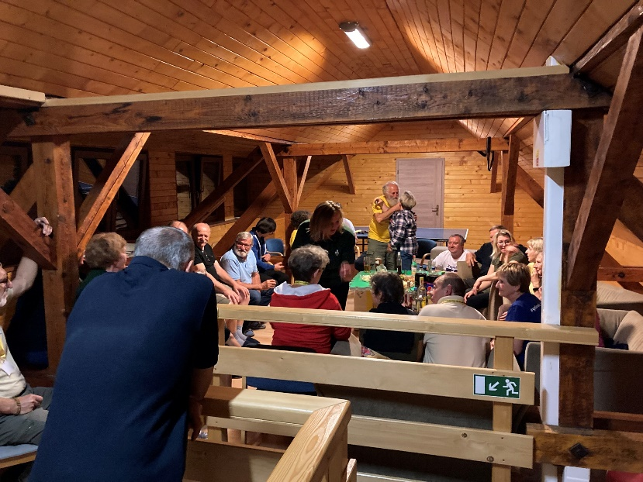
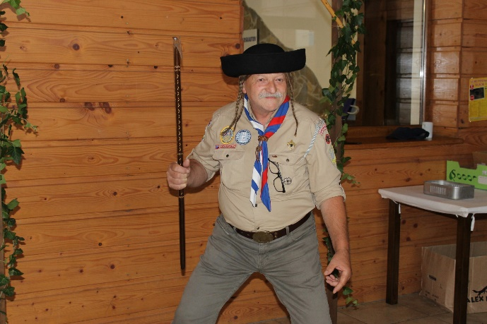
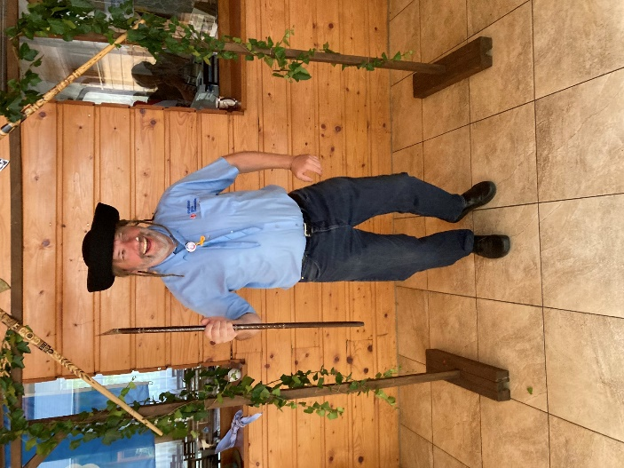
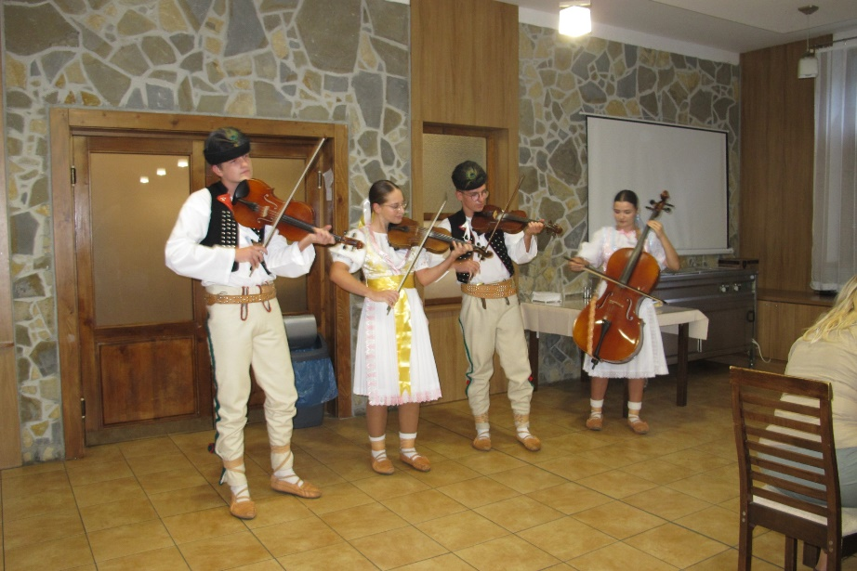
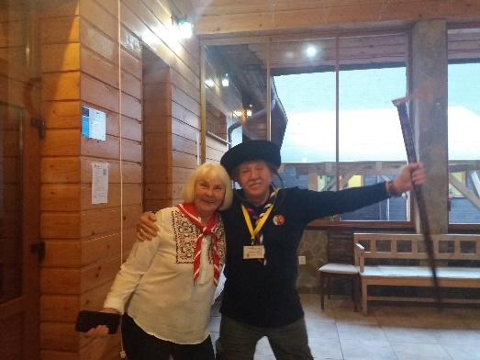
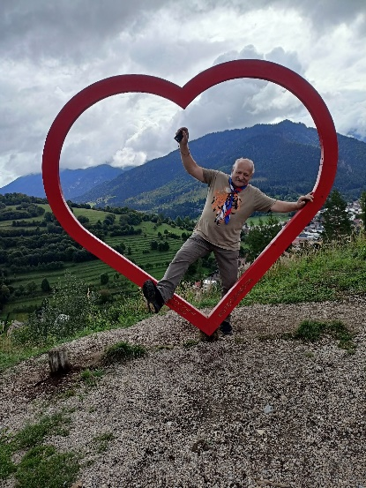
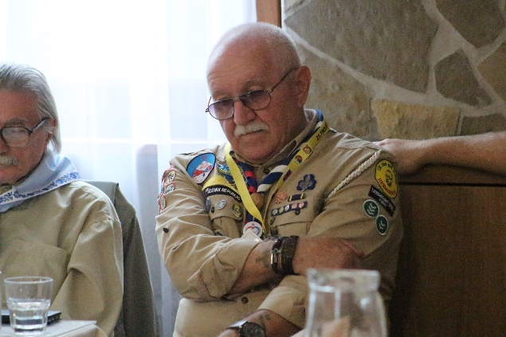
Funny time
Terchová – Šípková
8th - 11th September 2022

Slide 8
Tripartite meeting 08-11.09.2022
Meeting friends and making new contacts allowed us to participate in this year's Post Covid triple meeting of PL-CZ and SK countries. The weekend, threatened with bad weather, turned out to be favourable for our programme. The cordial get-together on Thursday with already known and new participants went on until late in the evening. Small gifts from members of the DSaSS as well as from the county, or treats from each country of the participants, pleasantly surprised and satiated. Friday started very early in order to reach all the main venues. The first stop was at the Okrasa factory, which specialises in the production of glass Christmas decorations. There we were able to witness the production process of one such Christmas bauble in different colours, shapes and sizes and then had the opportunity to buy the products in the company's shop. Afterwards, each group returned to their own country for a while, taking photos at the border posts. Our stay was made more enjoyable by a folklore ensemble of SK and girls from PL. The mayors of the border villages from Slovakia, Poland and the Czech Republic also honoured us with their presence, and a small-leaved lime tree was planted as a symbol of brotherhood, friendship and cooperation among the Scouts. The sign erected here will commemorate this event in Slovak, Czech and Polish. The signing of the agreements sealed further joint cooperation between the countries. We spent a pleasant time with a delicious lunch, singing and dancing, but that was not the end of the day, the next stop was Budatín Castle. During a tour of the interiors and exteriors, we could feel a piece of the history of this magical place. The evening presentation of the almanac of previous years, videos about the work of the scouts in Bohemia in the summer camp and the story of Juraj Janosik presented by Juraj Jakubisko opened the discussion window. The drizzle on Saturday morning did not deter us from our planned hikes to the Jánošík holes, the Terchová lookout or climbing the local Calvary. A reunion at the local church of St Cyril and Methodius, with the opportunity to admire the huge, moving wooden nativity scene, and a visit to the nearby Museum of Juraj Jánošík, with a documentary about his life and death, complemented by an exhibition of artefacts, brought us closer to local life. The opportunity to see cheese corkscrews being made live and to buy their products was welcomed by several participants. A tasty lunch in the form of cabbage soup filled us up, but some did not miss the opportunity to try the original homemade honey-flavoured beer from the Vršky brewery. In the evening, the conference took place, where all three countries were represented. A short cross-section of the history and important milestones of the ISGF on the occasion of its 30th anniversary was presented with small mementos. Big thanks for this. After a few words from the scouts from Bohemia and Poland, the meeting was livened up by the singing of a folklore ensemble. Some would have traded their last evening for an endless hour of conversation and the pleasant company of others. The last morning was part of the spiritual programme when, after Holy Mass and the common circle, everyone returned to their country, family and loved ones with a long farewell. In this way, the motto: "Without the past there is no future" was fulfilled. as the history of this meeting and the plans for the next meeting began to be written.

Slide 9
We look forward
to seeing you again next year

